Slide 1
Business Architecture Metamodel Update
2017 Summit Update

Slide 2
Overview
Business architecture framework recap
Business architecture knowledgebase
Knowledgebase and metamodel requirements
Sample metamodel from BIZBOK® Guide
What the Business Architecture Guild is doing to standardize metamodel views

Slide 3
The Value Proposition
Goal – create an international standard for a business architecture metamodel that aligns to and implements the underlying metamodel in the BIZBOK® Guide
The Win – any tool aligned to a standard metamodel based on BIZBOK® Guide can input and export and ideally represent standard business architecture representations as defined by best practices in the BIZBOK® Guide
Tools will align more readily to best practices and reduce customization often required by in-house teams
Business architecture work will be streamlined and expedited

Slide 4
Business Architecture Framework Relies on Robust Knowledgebase
Business Architecture Knowledgebase
Source of Basic Framework:
(BIZBOK® Guide)
Knowledgebase: Manages business architecture metadata and relationships in easily accessed facility
Blueprints: On demand and ad hoc business architecture diagrams, extracts and reporting
Scenarios: Specific business context shaped by business objectives, related challenges, action items, plans

Slide 5
Knowledgebase is Based on BIZBOK® Guide’s Underlying MEtamodel
Business architecture maps various business domains that need to be accessible in a wide variety of ways
This perspective is reflected in the BIZBOK® Guide’s business architecture framework
Managing a well-articulated business architecture requires a robust knowledgebase – the centerpiece of that framework
Best practices and emerging standards dictate basic relationships
Repositories, databases and third party software enable management of knowledgebase
Best practices are evolving into standards for managing this information
In all cases a robust metamodel is needed to enable tool vendors and practitioners to represent, exchange and disseminate standard business architecture blueprints and related representations

Slide 6
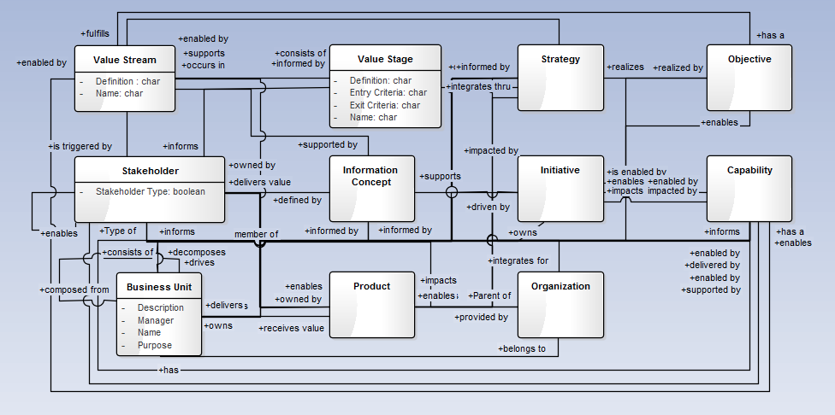
Sample Early Stage Metamodel from BIZBOK® Guide Part 5
Sample metamodel depicting relationships among business architecture artifacts
Source: BIZBOK® Guide Part 5

Slide 7
Current Work in Progress by Guild Metamodel Team
Metamodel Design
Inviting international participants
Finalizing the core mappings
Drafting the penumbra
Object Management Group
OMG Business Architecture Metamodel RFP drafted
Targeting standard submissions for 2018
Open Group
Guild is active member working on business architecture efforts
Contributing recommendations to update Open Group TOGAF™ content model
Vendor Engagement
Collaborating with tool vendors on metamodel design
Inviting vendors to join Guild in a formal submission response

Slide 8
Metamodel Team Roadmap (2017/2018 Timeline)
Q1
Q2
Q3
Q4
Q1
OMG RFP
RFP Response
MM Design
Core
Penumbra
Extensions
BIZBOK® Updates
Vendor Engagement
The team is working on multiple threads. Much work and time was spent in the last 12-18 months incorporating new thinking and approach for the metamodel, engaging constituencies in OMG to socialize and build consensus towards a Business Architecture Metamodel RFP, and working with the vendor community to outline opportunities for ongoing collaboration and participation for the future.

Slide 9
Capability as the centerpiece
Capability is the natural starting point for a business architecture because it describes “what” a business does in a way that supports analysis of various related business management concerns by:
Engaging business and operational stakeholders about their relevant concerns (current state), and
Guiding them towards a progressive set of steps to achieve their goals and objectives (strategy) for the short-term and long term (future states)

Slide 10
BIZBOK® Based, Layered MetaModel View
Represents “core” business architecture domains

Slide 11
First 2 layers of metamodel
Penumbra
Business Strategy Mapping
Initiative Mapping
Product Mapping
Stakeholder Mapping
Policy Mapping
BPM and Management
Case Management
Business Performance Mgmt.
Requirements Alignment
Core
Capability – Centerpiece defines WHAT the business does
Value – defines WHY the business has the capabilities
Information – HOW we build alignment between Capability, Value, and Organization
Organization – HOW we align resources to deliver value

Slide 12
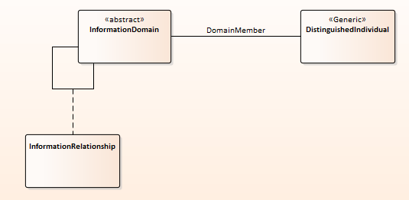
Metamodel Summary of core Business Architecture Domain Packages
Package: Capability
Package: Information

Slide 13
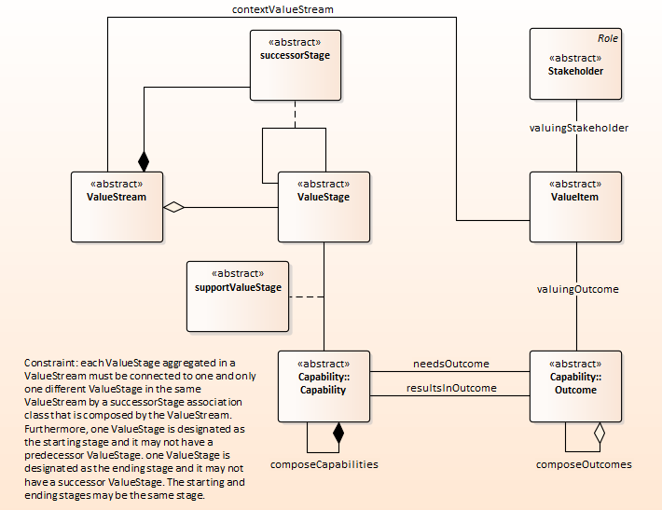
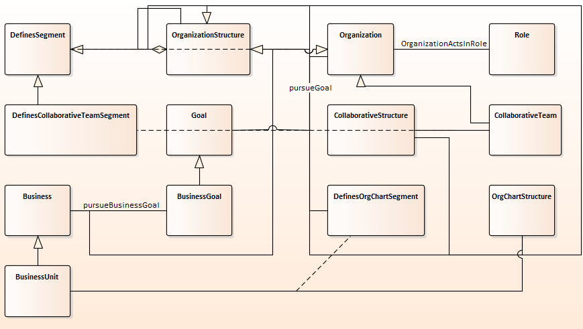
Metamodel Summary of core Business Architecture Domain Packages
Package: Organization
Package: Value

Slide 14
OMG RFP View of Business Architecture Metamodel Response Requirements
Capability required
Other representations desired
Must interface with existing standards
Capability Oriented Business Perspective

Slide 15
Scenario-Driven Business Architecture MetaModeling
The business architecture metamodel was derived from business architecture best practices as outlined in the BIZBOK® Guide and the organizations by leveraging common business scenarios
Investment Analysis
Shift to Customer Centric Business Model
Merger & Acquisition Analysis
New Product/Service Rollout
Globalization
Business Capability
Outsourcing
Supply Chain Streamlining
Divestiture
Regulatory Compliance
Change Management
Operational Cost Reduction
Joint Venture Deployment

Slide 16



Vendor Engagement – Discussion Engagement
Variations for candidate metamodel have been adopted, are under review for adoption, or have been or are being user implemented across numerous tool vendors
Candidate metamodel is based on the concepts captured across practitioner communities, as embodied in the BIZBOK® Guide, which has wide adoption across government, institutions, commercial, and non-profit (US & International)
Next steps – Guild will engage with vendor community in more focused ways to submit a response to the OMG RFP

Slide 17
Related Standards and Tool Work
Guild engaged with OMG for long-term to work on rollout and evolution of a standard metamodel
Guild also a member of Open Group to influence TOGAF® and its content model
Guild team has created a UML Profile for BIZBOK® for UML based tools
This could be standardized as well and aligns to the Guild metamodel

Slide 18
Thank you
We are looking for additional participants to accelerate
our efforts on this landmark work plan. Please contact the
Team Leader (Jeffrey Wallk) on the Guild Site (see link)
(http://www.businessarchitectureguild.org)

